Slide 1


STUDENT DIGITAL PORTFOLIO
Name : Manikandan.J
Register no and NMID : 24132251802521030
Departmet : B.sc.Computer science
College : Government Arts and Science College,
Vanur.Annamalai University.
Welcome 🤗

Slide 2

PROJECT TITLE
STUDENT DIGITAL PORTFOLIO
STUDENT DIGITAL PORTFOLIO

Slide 3

AGENDA
^{Problem Statement}
^{Project Overview}
^{End Users}
^{Tools and Technologies}
^{Portfolio design and Layout}
^{Features and Functionality}
^{Results and Screenshots}
^{Conclusion}
^{Github Link}

Slide 4

1.PROBLEM STATEMENT
Students often struggle to maintain and present their academic and non-academic achievements in an organized way. Traditional paper-based portfolios are difficult to update, lack interactivity, and cannot be easily shared.

Slide 5




2 . PROJECT OVERVIEW
2.PROJECT OVERVIEW
The Student Digital Portfolio is a web/app-based platform designed to help student collect, Organize and showcase their:
Academic records
Skills and Certification
Creative works(art, writing, photography, project etc.,)
Archivements and goals

Slide 6
3. WHO ARE THE END USERS
Student -> Create and maintain portfolio
Teachers/Mentors -> Review and evaluate student progress
Recruiters/colleges -> Access student skills and achievements
Parents -> View student growth

Slide 7


4. TOOLS AND TECHNIQUE
^{Frontend: HTML,CSS, Javascript}
^{Backend: PHP, Python, Node.js}
^{Database: MySQL,MongoDB}
Design Tools: Canva,Figma, Adobe XD
^{Version Control: Git/GitHub}

Slide 8



5. PORTFOLIO DESIGN AND LAYOUT
Home Page - Student intro, photo, motto
Academic Section - Marks, subjects, research project
Projects & Achievements - Project reports, competition, awards
Skills & Certification - Technical, soft skills, certificats
Creative Corners - Artworks, writings, performance
Reflections & Goals - personal growth statements, future plans
Contact Page - Email, Linkedln, QR code for sharing

Slide 9

6.FEATURES AND FUNCTIONALITY
User login & profile creation
Upload and organize documents, images videos
Add/edit/delete portfolio entries
Search/filter archivements by category
Responsive design (works on mobile & desktop)
Share portfolio via link or QR code
Download portfolio as PDF (optional)

Slide 10

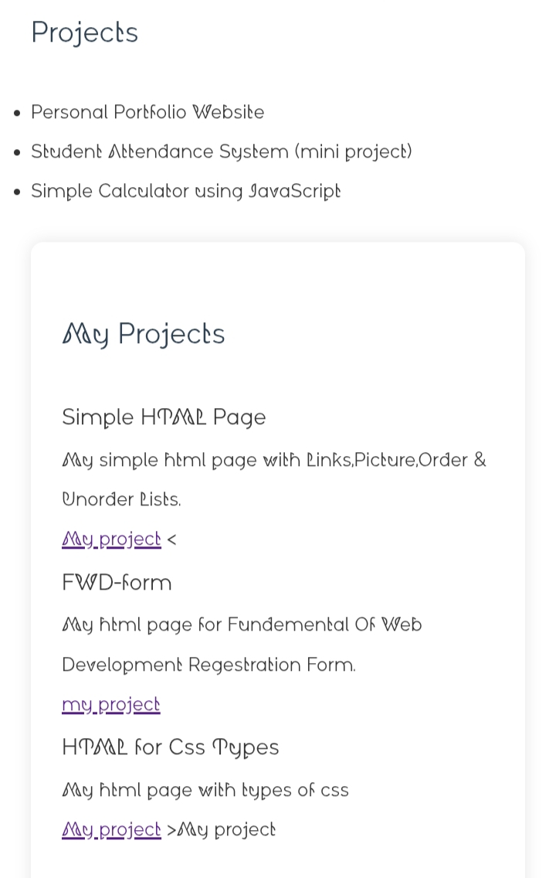
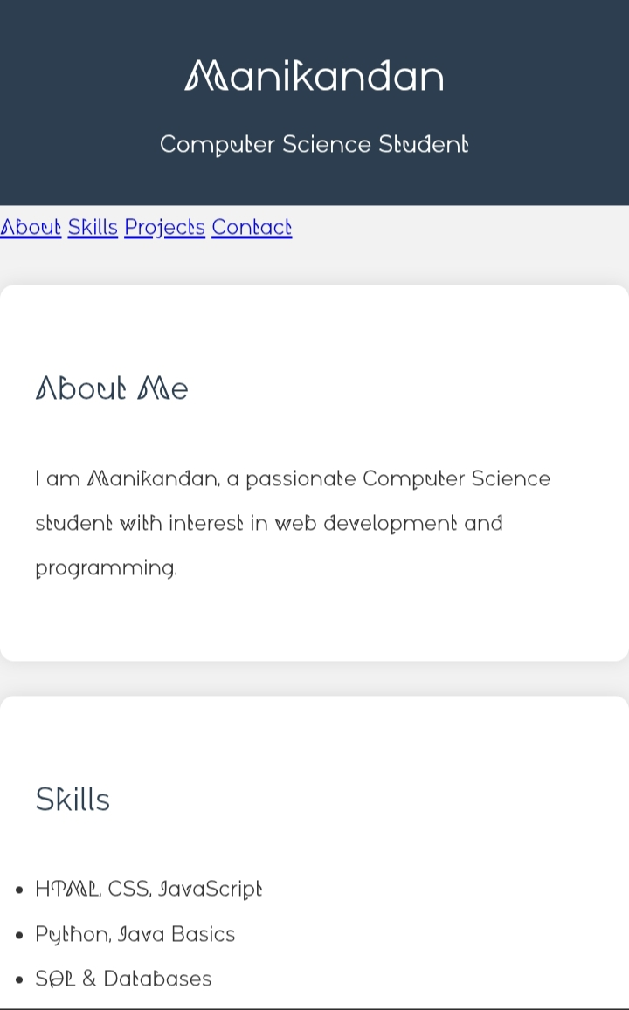
7.RESULTS AND SCREENSHOTS

Slide 11

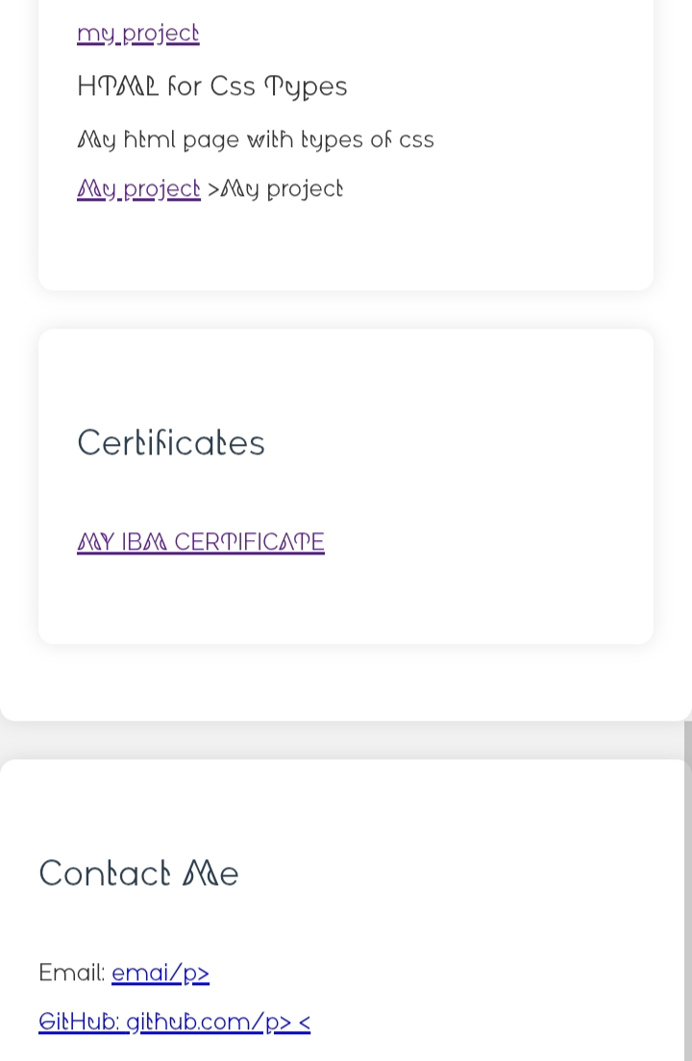
RESULTS AND SCREENSHOTS

Slide 12
CONCLUSION
This digital portfolio reflects my learning journey, skills, and achievements. It showcases not only the knowledge I have gained in academics but also my growth in creativity, problem-solving, and critical thinking. Through my projects, activities, and reflections, I have learned the importance of hard work, continuous improvement, and setting goals for the future.

Slide 13
GitHub Link
https://github.com/mmanijk25-debug/MANI-TNSDC-FWD-DP

